Slide 1




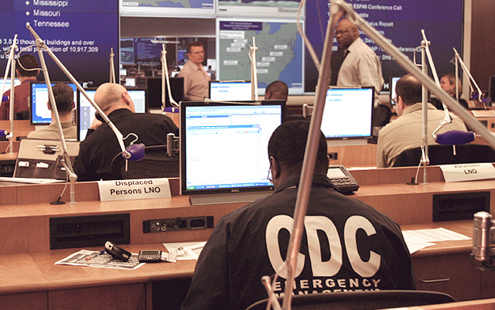
U.S. CDC Incident Management System
Centers for Disease Control and Prevention
Office of Public Health Preparedness and Response

Slide 2

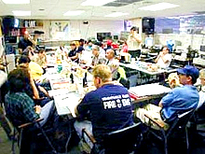

Incident Management System
Provides the template for incident management, regardless of cause, size, location, or complexity
Applicable at all jurisdictional levels and across functional disciplines
Enables federal, state, and local governments, the private sector, and non-government organizations to work together

Slide 3
Benefits an Incident Management System
Standardized, scalable and flexible approach
Enhanced cooperation and interoperability
Efficient resource coordination
Comprehensive all-hazards preparedness
Incorporates measurable, achievable objectives
Incidents are managed at the lowest possible geographic, organizational, and jurisdictional level

Slide 4
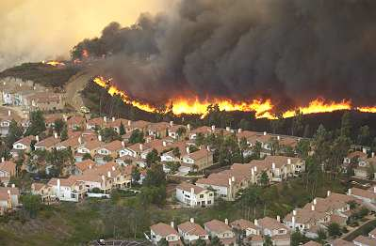
Who Uses an Incident Management System?
Federal Departments and Agencies
State Agencies
Local Responders
Private Industry

Slide 5
When Should Public Health use the Incident Management System?
Communicable Disease Outbreaks: E. coli, West Nile Virus, Plague, SARS, Hepatitis, Hantavirus
Non-Outbreak Situations: Flooding, disruption of utilities, mass immunization campaigns (flu, Hep A), community events, mass gatherings
Emergency Medical Services: Multi-patient and mass casualty events, trauma events

Slide 6
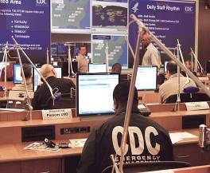
CDC’s Emergency Operations Center
Managed by the OPHPR Division of Emergency Operations (DEO)
DEO provides CDC's core Incident Management Structure
Functions as CDC’s command center for coordinating emergency responses to domestic and international public health threats
Staffed 24/7/365 to provide worldwide situational awareness
Coordinates CDC’s preparedness, assessment, response, recovery, and evaluation for public health emergencies
Serves as the central point of contact for state agencies reporting potential public health threats to CDC

Slide 7
CDC Incident Management System All-Hazards Organization Chart

Slide 8
Incident Manager (IM)
Obtains approval to activate the Incident
Management Structure.
Maintains overall situational awareness of the event and all deployed CDC resources.
Obtains briefings on the incident and approves
briefings to be presented to the agency director.
Establishes incident priorities; approves incident objectives.
Comes from the Primary Center responsible for the event.

Slide 9
Chief Health Officer
Oversees the Scientific/Technical Response.
Advises the IM on scientific and health issues.
Defines qualifications for various types of CDC staff that may be deployed.
Assures that scientific qualifications are met prior to deployment.
Reviews media releases and other documents for scientific accuracy.

Slide 10
Chief of Staff
Supervises and coordinates the details of the CDC IMS response.
Ensures the staff provides the IM updated estimates and plans for future actions.
Supervises the staff’s synchronization.
Supervises information flow in and out of the staff.
Oversees the General Staff support sections.

Slide 11
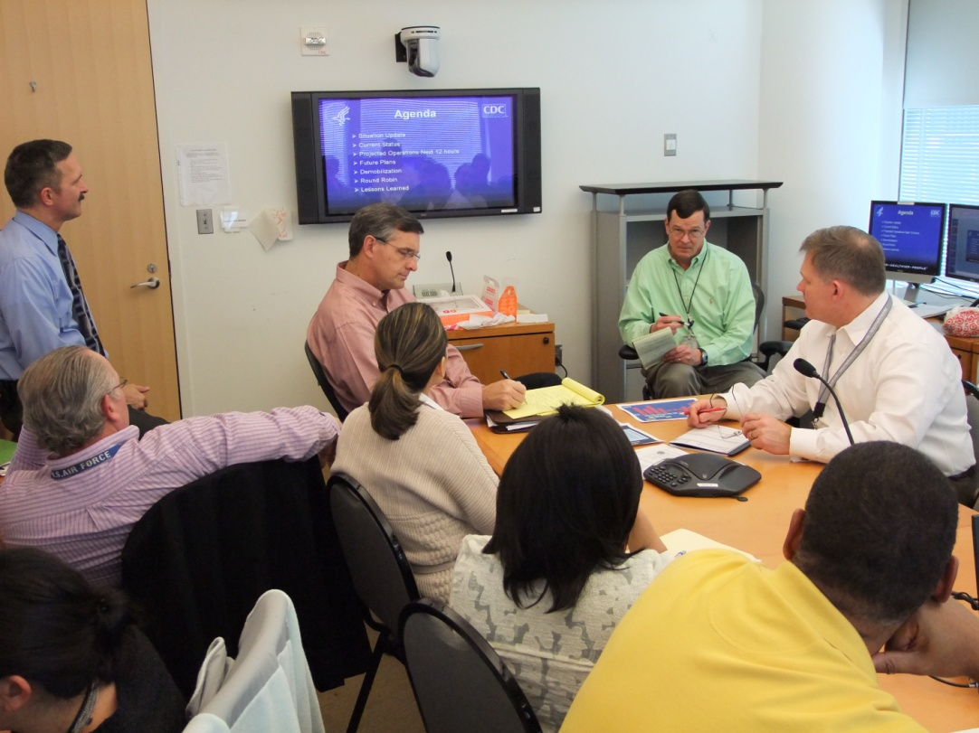

General Staff
Supports the scientific response for the incident
Provides Public Health messaging to the public
Manages the CDC emergency operations center (EOC)
Prepares and publishes CDC Incident Action Plans (IAPs) and Situation Reports (SITREPs)
Provides logistical and financial support for the incident response
Resources personnel and staffing for the incident response
Improves Situational Awareness by integrating and managing critical information

Slide 12
Joint Information Center
Delivers accurate, coordinated, timely, and accessible information to affected audiences, including governments, media, the private sector, and the local populace, including the special needs population
Structure works equally well for large or small situations
Analyzes public perceptions
Informs the public

Slide 13


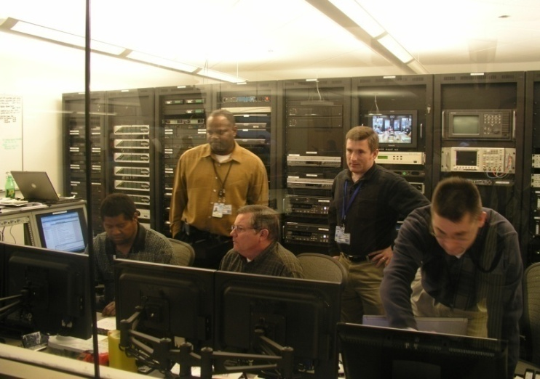
Operations Section
Manages the CDC’s command center (EOC) for coordinating emergency responses to domestic and international public health threats
Core Staff 24/7/365 to provide worldwide situational awareness
Serves as point of contact for state agencies reporting potential public health threats to CDC
Monitors DCIRs

Slide 14
Operations Mission
To inform, coordinate, and enable CDC’s response activities 24/7/365.
Inform decision makers of all Director’s Critical Information Requirements (DCIR)
Coordinate the daily utilization of CDC resources to support public health requests and inquiries for all incidents and exercises.
Ensure the EOCs and COOP sites are operationally ready to support CDC CIOs in public health responses.

Slide 15
Operations (OPS)
Ops Branch Chief
Peter Rzeszotarski
Deputy
Watch Team Lead
Current Ops Lead
Support Team Lead

Slide 16
Organizational Structure Response
Operations Section
Current Operations Lead
Duty Officer
EOC Support Lead
Response Coordinator
Preparedness Coordinator
Task Lead
Tasker
Task Tracker
Watch Officer
Information Operations Coordinator
Audiovisual
Support
Administrative Support
Applications Support
IT
Support

Slide 17

Roles and Functions – The Watch Team
Provides 24/7/365 support as:
A central link between state/local health departments and CDC SMEs.
A health and safety link between CIOs and their staff (both those on travel and those assigned overseas).
A source of situational awareness of all operationally relevant information for CDC leadership and HHS.

Slide 18
Director’s Critical Information Requirements (DCIRs)
The Watch Team priorities are guided by the DCIRs
Internal DCIRs:
Accidental death or injury of CDC personnel
Events affecting CDC installation activities/operations
Incidents of international significance affecting CDC staff
National and global DCIRs
Disease outbreaks/deaths that are above the base line for the seasonal or geographic norms
Any chemical, biological, nuclear threats or events
DCIRs for specific events

Slide 19
Epidemiology and Surveillance Linkage
Central point of contact for:
BioSense analyses
Program-specific surveillance reporting
State Epidemiologists and field-assigned Career Epidemiology Field Officers (CEFOs)
Translation into reports
SPOTREPS
SITREPS
Daily Report

Slide 20
Laboratory Linkage
BioWatch
Select agent detection and alerting
Presumptive positive test results for select agents reported to EOC.
EOC coordinates with CDC laboratories for confirmatory testing.
EOC leadership notified if there is a confirmed positive test result for a select agent.
Laboratory Response Network
(integrated network of state and local public health, federal, military, and international laboratories that can respond to bioterrorism, chemical terrorism and other public health emergencies.)
Proficiency testing and communications drills

Slide 21
Roles and Functions – Current Ops Team
Develops, coordinates and implements policies, procedures, and protocols.
Enhances preparedness of the Operations Branch by conducting training on these policies, procedures, and protocols.
Coordinates and manages all aspects of response and exercise activities with internal and external partners.
Enables the activation of the EOC and serves as the crisis action team for all operational coordination.

Slide 22
Policies, Procedures and Protocols
National policies and doctrine followed in all operational activities
Procedures and protocols updated annually
Standard Operating Procedures and all Annexes for responding to general situations
Disease- or disaster-specific protocols for actions not requiring approvals

Slide 23
Tasking and Tracking
Sources of taskings:
External requests for information / action
External mission assignments
Internal directives
Tasking details:
Date and time received
Task origination
Tasking details (product or action needed)
Who will respond
Due date
Status
Completion date

Slide 24
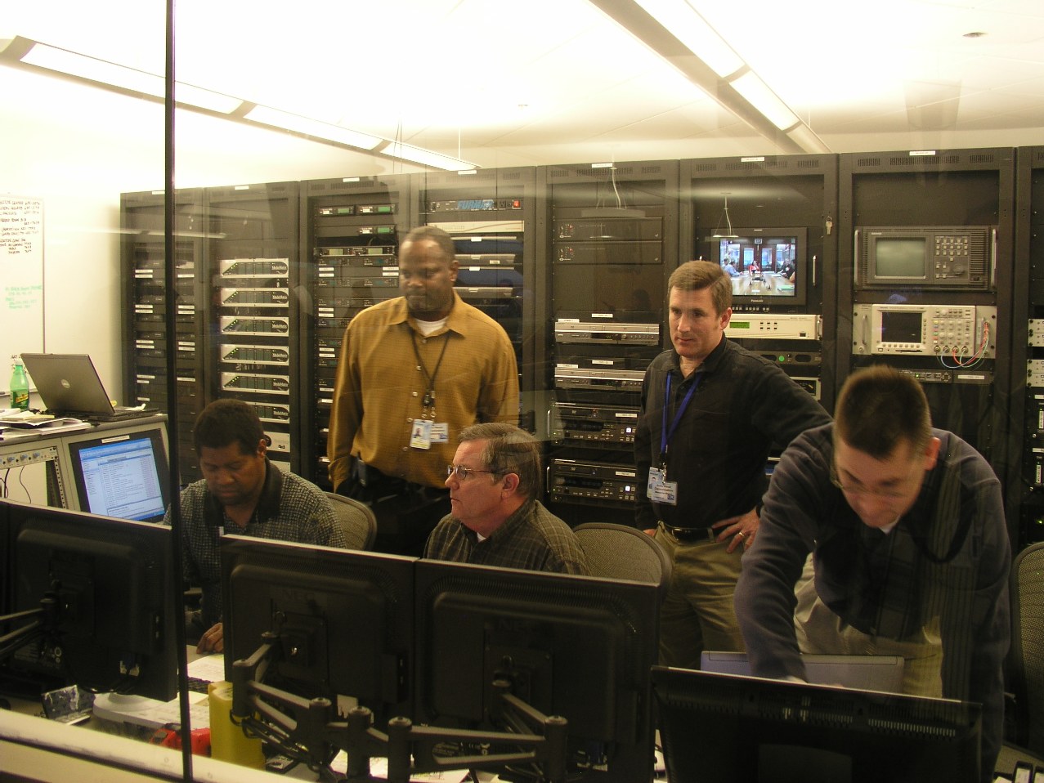
Roles and Functions – EOC Support Team
Provides audiovisual, communications, and administrative support
Maintains equipment and ensures the readiness of both the EOC and its Alternate Operating Facilities
Conducts functional tests and communications exercises

Slide 25
Planning Section
Produces agency situation reports (SITREPs)
Develops agency incident action plans (IAPs)
Develops event-specific courses of action, short & long range planning, & contingency planning
Facilitates the development of Agency response objectives
Ensures event-related documentation is maintained for post-response investigations, inquiries, and reviews
Conducts after action reviews
Develops improvement plans

Slide 26
Plans, Training, Exercises and Evaluations (PTEE) Branch
Plans, Training, Exercises and Evaluations
Branch Chief
Support Staff
(Deputy, Science, Admin)
Plans Section
Training, Exercises and Evaluations Section
Training
Exercises
Evaluations

Slide 27
PTEE Mission Statement
Develops, writes, coordinates and publishes CDC plans for all-hazard responses
Develops the individual, staff and collective training requirements for response plans and EOC activations
De-conflicts, integrates and synchronizes the scheduling, design, development, and conduct of CDC exercises
Provides for effective analytical assessments and evaluations of the agency’s exercise and response operations

Slide 28
Incident Action Plans
An Incident Action Plan (IAP) is a document prepared during a response for each operational period. The purpose of the IAP is to:
Ensure response personnel are working toward the same goals by providing direction for actions to be taken during the operational period identified in the plan
Provide a coherent means of communicating the incident objectives for operational and support activities. This includes measurable strategic objectives for the operational period
Reduce freelancing and ensure a coordinated response

Slide 29
After-Action Reports
An After Action Report (AAR) provides a description of what happened, why it happened, how it can be done better, and lessons learned by participants involved in a response. The report is generated from a structured discussion with participants.
An AAR:
Does not judge success or failure
Attempts to discover why things happened
Focuses directly on the tasks and goals that were to be accomplished
Encourages employees to surface important lessons in a discussion
Helps inform and improve CDC’s understanding of the process behind a response, as well as the strategies and tactics employed before, during, and after an event

Slide 30

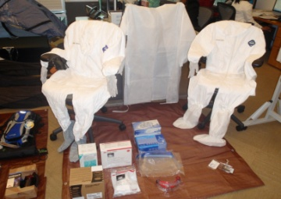
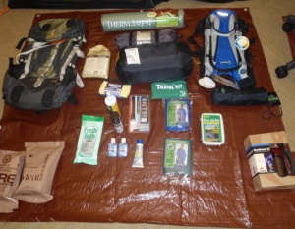
Logistics Section
Manages all event logistical support requirements
Provide travel support (International and Domestic)
Coordinate shipping and aircraft to support operations
Provide deployment equipment and supplies
Provide laboratory and medical supplies to CDC teams

Slide 31
Logistics Mission
To provide 24/7/365 logistics support (materiel, transportation, and travel) to deploying or deployed CDC personnel, including the EOC, in support of CDC outbreak and emergency response activities to enable successful mission accomplishment.

Slide 32
Logistics Branch
Procurements
Logistics Branch Chief
Finance
Deputy Branch Chief
Scientific Resources
Science Liaison
Support Services Lead
Travel & Trans Lead
Equipment Lead
Logistics Planner
2 Admin Asst
Travel Approver
3 Equipment staff
2 Travel Preparer
Communications
Transportation

Slide 33
IMS Logistics and Finance
Logistics
Section
Support Branch
Incident Support
Teams
Communication
Travel /
Vouchers
Facilities
Procurement
Cost Tracking
Transportation
Finance
Receiving /
Policy
Distribution
Scientific
Resources

Slide 34

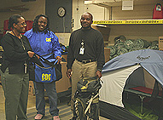

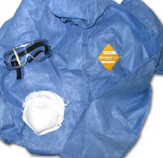

Material Management Functions
Property management and accountability
Logistics planning during emergency
response, including COOP events
Procure and manage supplies and
equipment to support emergency deployments

Slide 35

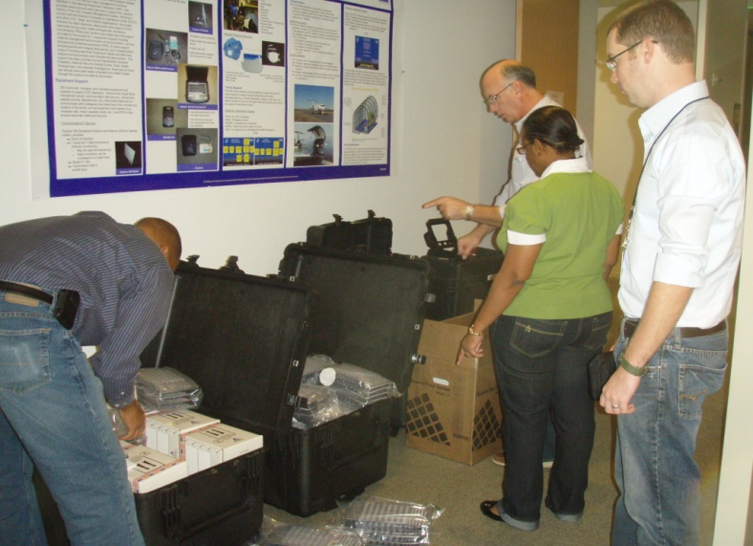
Transportation Functions
Coordinate equipment and personnel transportation
Provide emergency travel coordination 24/7/365
Process travel vouchers for emergency travel
Coordinate and track specimens, supplies, and equipment shipments
Coordinate medical evacuation missions

Slide 36
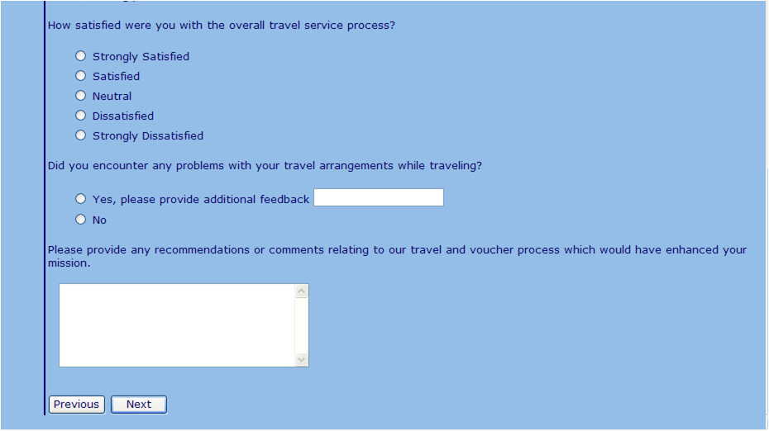
Support Services Functions
Conduct program surveys, audits, and projects, and develop tools to measure and enhance the effectiveness of LSB programs.
Customer satisfaction survey
Voucher processing
Telecommunication cost management for DEO and OPHPR

Slide 37
Facilities / Space Management
EOC Surge Space
19 conference rooms
10 classrooms/conference rooms
EOC 1 (Ops)
Surge space set-up:
Coordinate w/ IT for computers and phones
Coordinate w/ Facilities for lights, HVAC
Coordinate w/ Ops for AV and Admin support
Coordinate w/ Security for Parking and access
Scheduling surge space use – teams, meetings

Slide 38
Finance and Procurement Section
Finance Branch
Staffed by Financial Management Office
Provides event/incident related cost tracking and finance policy
Procurement Branch
Staffed by Procurement and Grants Office
Provides market research assistance
Procures supplies / services
Deploys Federal Contracting Officers
Finance & Procurement
Section
Procurement
Finance Branch
Branch
Procurement
Cost Tracking
Requisition Management
Finance
Policy
Notes:
38

Slide 39
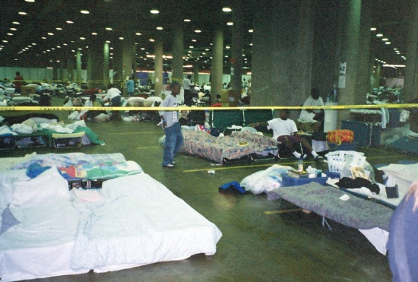
Emergency Personnel Staffing Section (EPSS)
Resources, coordinates and ensures compliance with CDC instructions for deployments
Emergency Personnel Staffing Section
Organizes deployment briefings
Commissioned Corps
Coordinator
Coordinates with Emergency Coordinators
Deployment Brief
Coordinator
Manages personnel utilization rosters
Field Deployment
Activity
Coordinates IMS Staffing requirements and Rostering
Staffing
Coordinator Activity
Coordinates requirements for EIS officers
EIS
Coordinator

Slide 40
Situational Awareness
Improves vertical and horizontal information sharing
Provide analytical and geospatial information products
Collect, coordinate, process and analyze disparate data to produce actionable information to support operational needs, and
Monitor worldwide “All Hazard” conditions for possible CDC international or national response operations

Slide 41
Situation Awareness
Organization Structure
Jim Tyson (icf8)
Chief
Deputy
Information Operations
Health Scientist
Knowledge Management
Public Health Scientist
Information Operations
Information Analyst

Slide 42
Situation Awareness Mission
To provide CDC with a global “All Hazards” Situation Awareness capability to improve information sharing, support unity of effort & enhance decision support by implementing Knowledge Management capabilities and processes to support CDC response operations.
Know Sooner. Know Faster.
And as a Result: Respond Sooner and Adapt Faster.

Slide 43
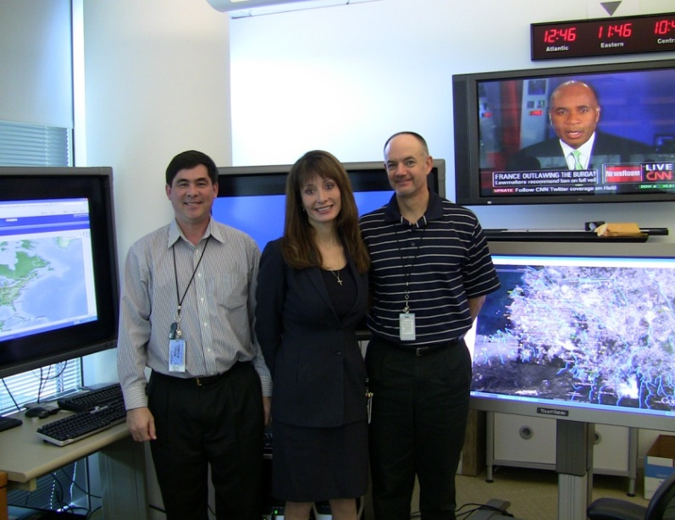
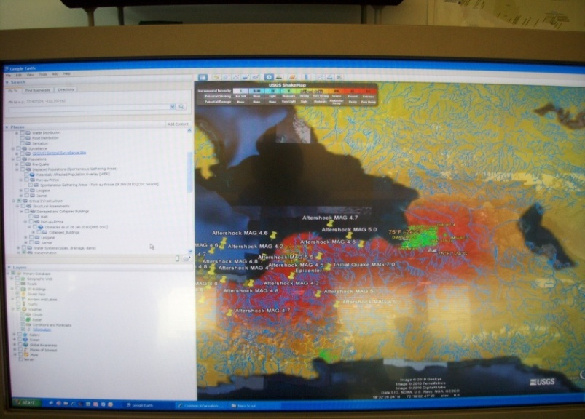
Situational Awareness
Improve vertical and horizontal information sharing,
Provide support and collaboration to the CDC IMS personnel,
Provide analytical and geospatial information products
Develop and maintain Knowledge Management and social-networking capabilities
Collect coordinate, process and analyze disparate data to produce actionable information to support operational needs, and
Monitor worldwide “All Hazard” conditions for possible CDC International or National response operations.
Notes:
43

Slide 44
Emergency Risk Communications Branch

Slide 45
Operations
Team
Epi-X and HAN Team
Budget & Program Asst.
Leadership
Triage Section
Clearance Section
Web & Social Media Team
Health Partners Outreach Team
Clinician
Communication
Section
Comm. Surveillance & Evaluation Team
State & Local Partners & Crisis and Emergency Risk Communication Training
Community Health Outreach & Education Section

Slide 46
Mission
The Emergency Risk Communication Branch leads CDC’s emergency communication for all-hazards preparedness and response. The Branch ensures timely, consistent, targeted, and actionable information reaches the public and stakeholders during emergencies.

Slide 47
Day to Day Functions
Leads agency-wide emergency risk communication planning and preparedness activities
Manages selected channels that deliver national emergency and terrorism-related messages
CDC’s Emergency Preparedness and Response Website
Health Alert Network
Epi-X
Clinician Outreach and Communication Activity and Registry
NGO and Government partner channels
Professional list-servs

Slide 48
Day to Day Functions
Liaison to federal interagency public affairs group
Provides technical assistance in emergency risk communication to internal and external partners and supports emergency risk communication capacity building

Slide 49
Response Functions
Lead the Joint Information Center (JIC) in CDC’s Emergency Operations Center
Identify/execute strategies for translation and delivery of CDC’s emergency risk communication messages and information to key targeted audiences
Coordinate cross-agency communication activities

Slide 50
Response Functions
Monitor news media, social media, public inquiries, and channel traffic
Coordinate CDC communication activity with state, local, federal, and international response
Manage rapid, consistent distribution of emergency information through multiple channels

Slide 51
Scientific Response Section (SRS)
Science based response SMEs (Subject Matter Experts)
Provides technical guidance to IM in response to requests
Coordinates to ensure response operations are scientifically based
Prepares data and reports for the Incident Action Plan
Develops and conducts scientific interventions/courses of action
Can vary in size from individuals to teams to task forces

Slide 52

International Coordinator
International travel of deploying staff
Communications with international organizations and deployed staff
Subject matter expert on:
The countries' customs,
culture, and language(s)
National or International Health partners and how they are involved
Political and government structure, including areas of violence, corruption or unrest affecting the ability to provide assistance

Slide 53
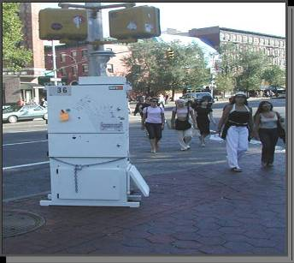
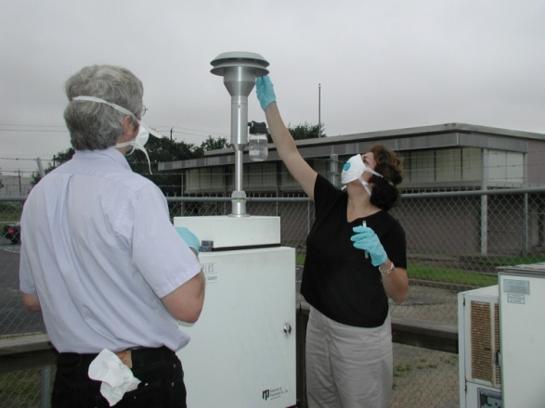
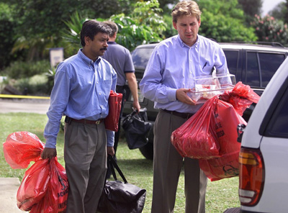
Epidemiological and Surveillance
Provides the capability to collect, analyze, interpret, and manage public health-related data
Conducts public health surveillance and detection
Conducts public health and epidemiological investigations
Identifies the source of a case or outbreak of disease, injury, or exposure and its determinants in a population
Recommends, monitors, and analyzes mitigation actions

Slide 54

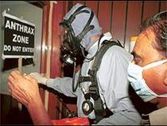
Public Health Laboratory
Provides the capability for rapid detection, characterization, confirmatory testing, data reporting, investigative support, and laboratory networking
Address actual or potential exposures
Capability supports pre-event, pre-incident, and post exposure surveillance

Slide 55

Community Mitigation
Employed to slow the spread of disease and when a vaccine is not available at the outset of a pandemic
Includes social distancing strategies and recommendations to reduce contact between people:
Closing schools
Canceling public gatherings
Planning for liberal work leave policies
Teleworking strategies
Voluntary isolation of cases
Voluntary quarantine of household contacts

Slide 56
Infectious Disease
Guidance for the prevention of infectious diseases
Guidelines for relief staff, travelers, and the public on infection control, quarantine issues, and management of chronic diseases
Coordinate disease surveillance with the Epidemiology/Surveillance Team
Assist with quarantine issues that may arise in temporary shelters/hospital situations
Coordinate with the Environmental Food/Water Team and the Vector/Rodent Team.

Slide 57



Worker Health and Safety
Promotes the integration of occupational safety and health protection
Prevents worker injury and illness
Advances health and well-being
Uses evidence-based health promotion strategies
Transfers knowledge into practices and products that protect and promote worker health and safety

